Slide 1
Normstorm A gender equality project with focus on labor market in the Umeå region

Slide 2
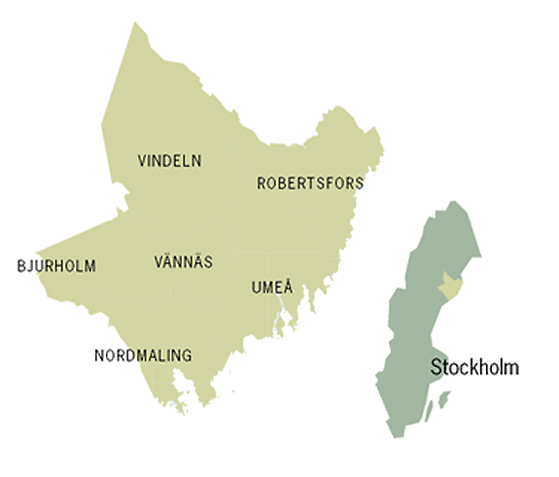
Six municipalities in collaboration since 1993
Bjurholm
Nordmaling
Robertsfors
Umeå
Vindeln
Vännäs

Slide 3
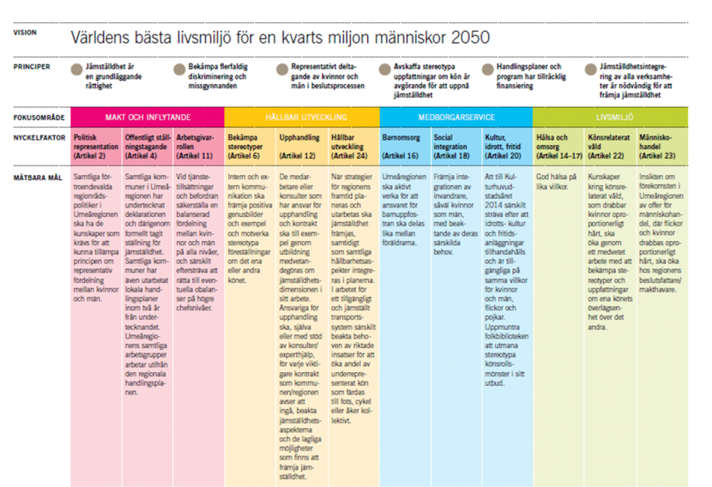
The Umeå region and gender equality
The Umeå region consist of regional working groups for collaboration in 20 different areas of work within the municipalities, ex Culture, Communication, Turism, Integration and Gender equality.
Umeå Region working group for gender equality .
The six municipalities in the Umeå region have all signed the
European charter for equality of women and men in local life.
Based on the European charter for equality
The regional working group for gender
equality have produced a regional charter
for equality of women and men.
Approved by the Regional council Sep 1 2010.

Slide 4
Project Normstorm
Umeå Region working group for gender equality came up with project Normstorm. Approved by the Regional council 2010.
Normstorm started in May 2011 and finishes in december 2012.
Project Normstorm is one way for the municipalities to focus on activities based on the regional charter for equality of women and men.
Project Normstorm continues previous work with gender equality within the Umeå region that started with earlier projects, ”Hållbara Umeåregionen” och ”Jämställdhet, genus och förändringsarbete i Umeåregionen”.

Slide 5
What’s the problem? The gender- segregated labor market in Västerbotten county
Normstorm Background
Implications:
People will choose their profession not according to interest or skill but according to gender label.
Gender labels for professions will impair the matching-process between employers and employees .
A gender-segregated labor market will therefore impoverish incentive for economic growth.
SCB

Slide 6
Normstorm Project goal and goal realisaion
Project goal: Through partnership och experience-sharing with public and private employers, the project will contribute to an increase in mobility between traditional female and traditional male workingsektors within the Umeå region.
Goal realisation:
Collaboration with private and public employers in the six municiplaities within the Umeå region.
Collaboration and networking with other actors within the field for gender equality in the Umeå region.
Education in gender equality, norm-critical view and norm- critical recruitment strategies.

Slide 7
Normstorm
To approach a broad problem you need a
wideranging solution.
Financiers in project Normstorm:
Swedish Agency for Economic and regional growth. (Tillväxtverket)
Västerbotten region (Region Västerbotten)
The Umeå region (Umeåregionen )
The Forestry Technology Cluster (Skogstekniska klustret )
Umeå university (Umeå Universitet )
The swedish employment office (Arbetsförmedlingen)
Project group:
Projekt coordinator: Johanna Engström ,100 %
Lokal project leder: Emma Möller, 100%
The Forestry Technology Cluster
Public Employers
Private Employers
Employment office
School
Umeå university

Slide 8
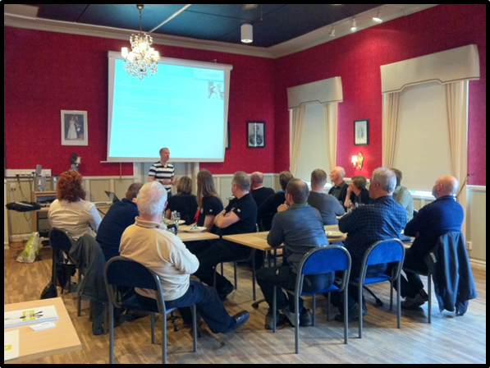
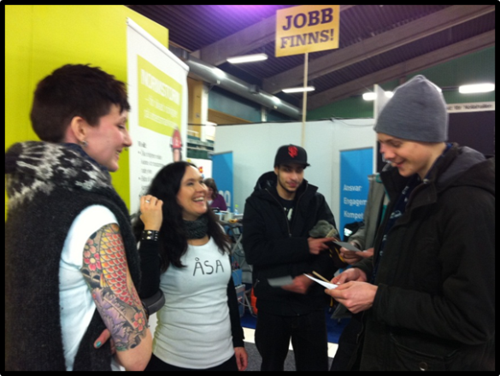
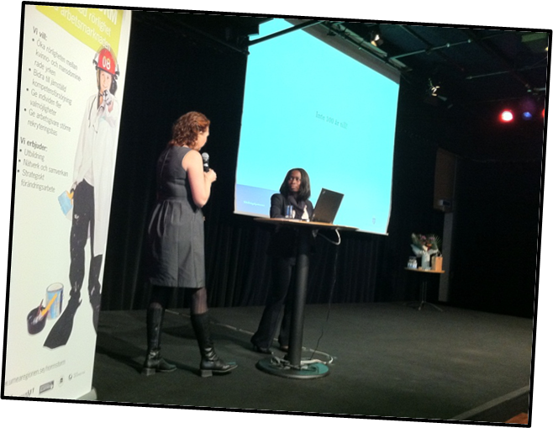
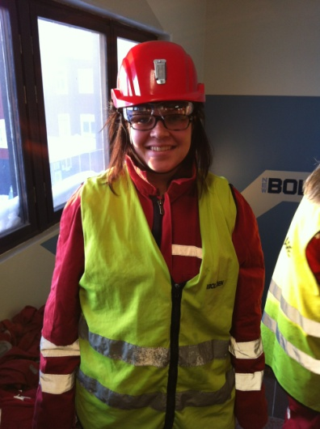
Normstorm Examples of Activities
Examples of activities:
Education in norm-critical views for teachers and student counsellors in secondary schools and highschools in the Umeå region.
Education in anti-discrimination strategies for leaders and workers at Komatsu Forest, a large forestry company.
Education in gender equality for leaders and workers within the public sector, ex ample, Umeå cleaning unit.
Two-day seminar in gender equality and norm- critical views in recruitment, for leaders and workers in the personnel department within the six municipallities.
A network for gender education of personel working within the administration of the six municipalleties in the Umeå region.

Slide 9
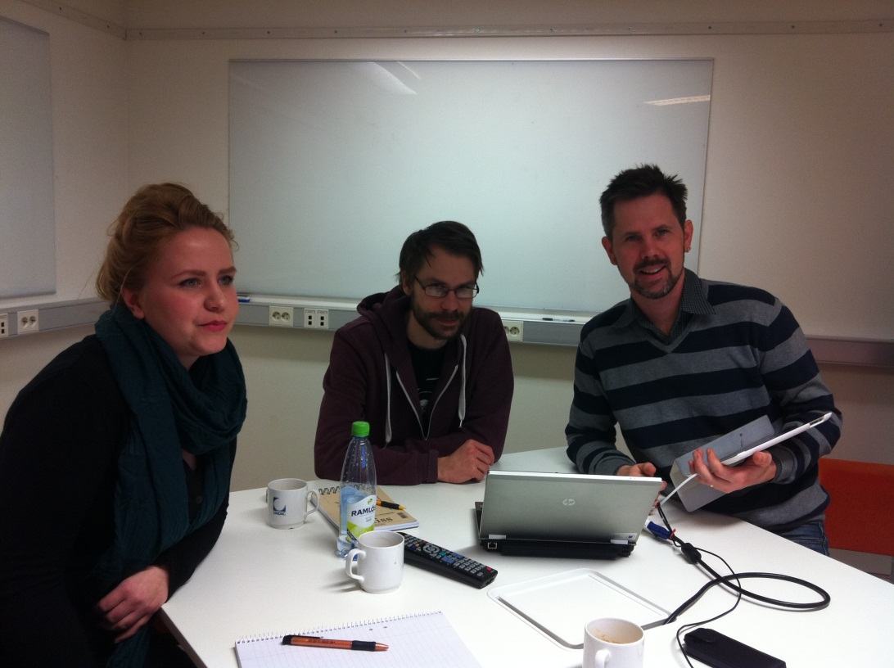
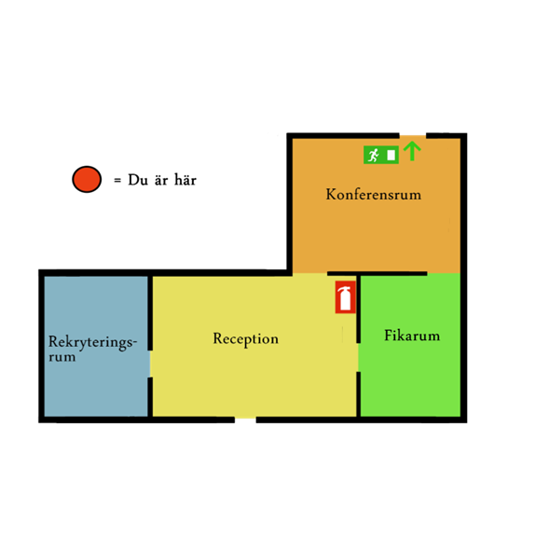
Web-based course in gender equality
Basic education in gender eqality
for the workplace.
Includes information about the European
charter for equality of women and men, and
the national political goals in gender equality
established by the gouverment.
Target group: Employers in the Umeå region.
Usage: Give employers end employees a
common ground in working with gender
equality in the workplace.
Avaliable: November 2012.
Via Umeå region webbsite.
The web-based education in gender equality is produced by project Normstorm and a team of local consultants from the fields of Gender equality, Information technology, Design, Media and Communication.

Slide 10
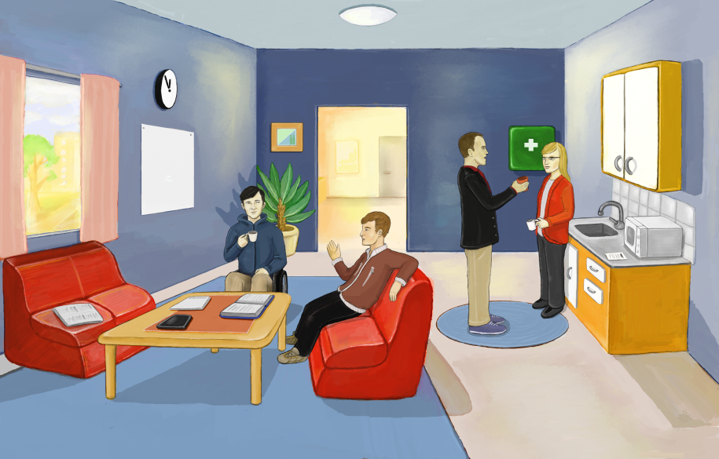
Web-based course in gender equality
Content in knowledge:
Reception: Basic knowledge of gender equality , the swedish anti-discrimination law, information about the national political goals in gender equality, gender in media and communication.
Breakroom: Discrimination, harassment and jargon in the workplace.
Recruitmentroom: Norm- critical recruitment strategies. Information about the local labour market in a gender perspective.
Conferenceroom: Dominant behaviour in the workplace, Working with gender equality with focus on external contacts/clients/citizents.
All rooms includes:
Case/Questions/Scenarios
Method/Tools for working with gender
Incentives to work with gender
Best practice or local examples

Slide 11
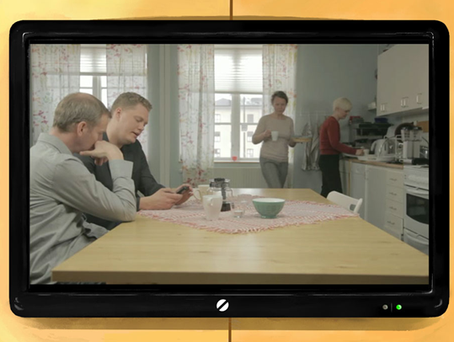
Web-based course in gender equality
A local theatregroup from Umeå, Profilteatern, have produced films that demonstrates situations with diskussions about gender issues in a workplace.
Several local employers from the Umeå region are featured as good examples of workplaces that have started working with gender equality.
All the information presented in the web-based education will also be avaliable on the Umeå region website in the form of material you can download or print out.

Slide 12
Contact
Johanna Engström
johanna.engstrom@umea.se
070-600 93 44
Emma Möller
emma.moller@nordmaling.se
070-270 62 66
www.umearegionen.se/normstorm
Vi har även en facebooksida!

